Slide 1
Kidney only

Slide 2
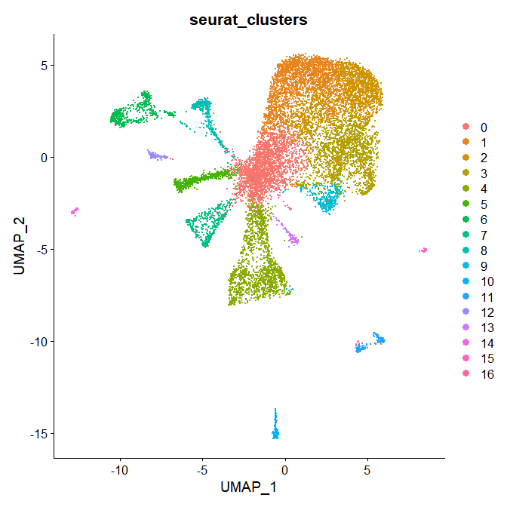
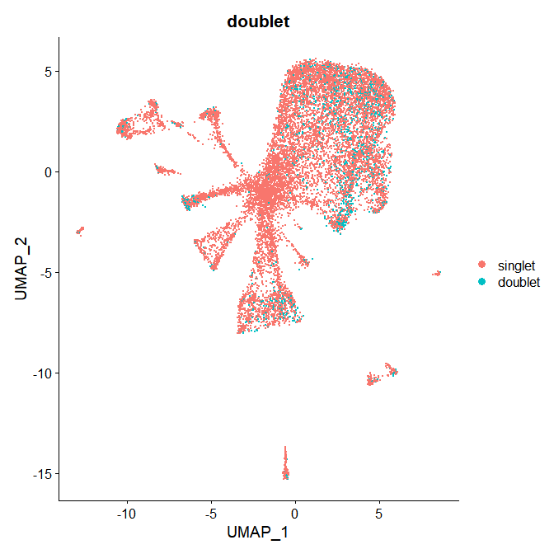
Pre-integration doublet assessment - MH6
11.7% doublet rate

Slide 3
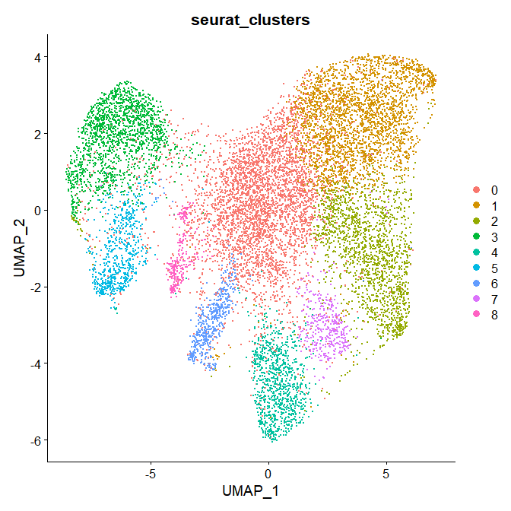
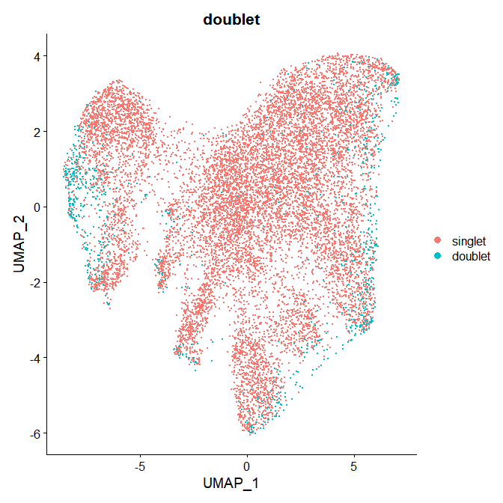
8.1% doublet rate
Pre-integration doublet assessment – MH7

Slide 4
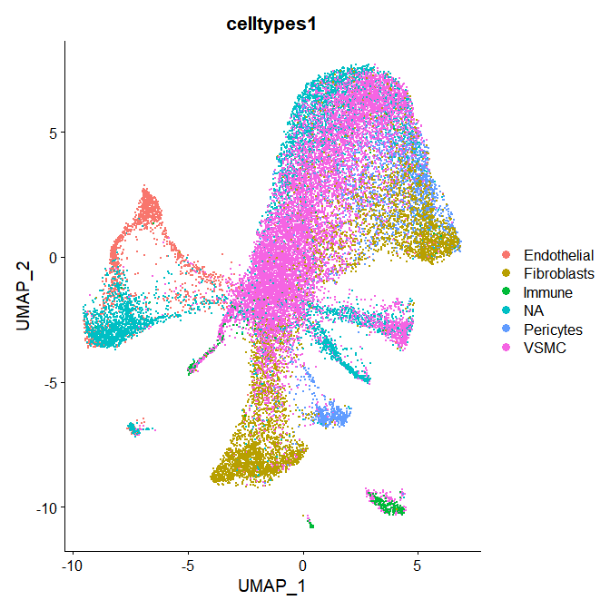
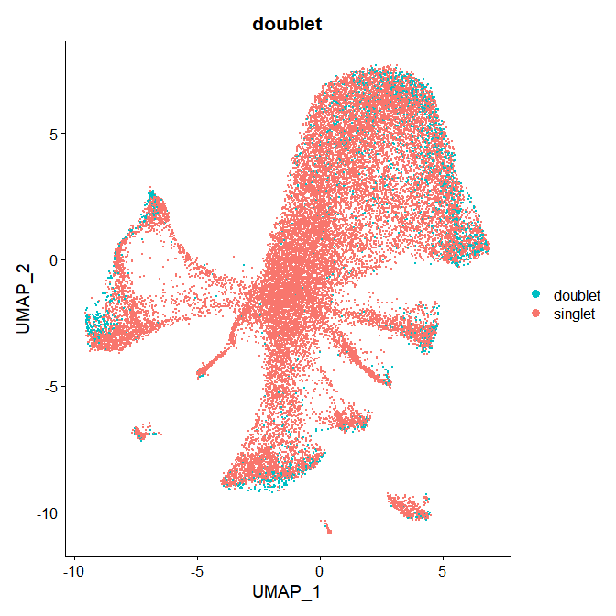
Integrated data

Slide 5
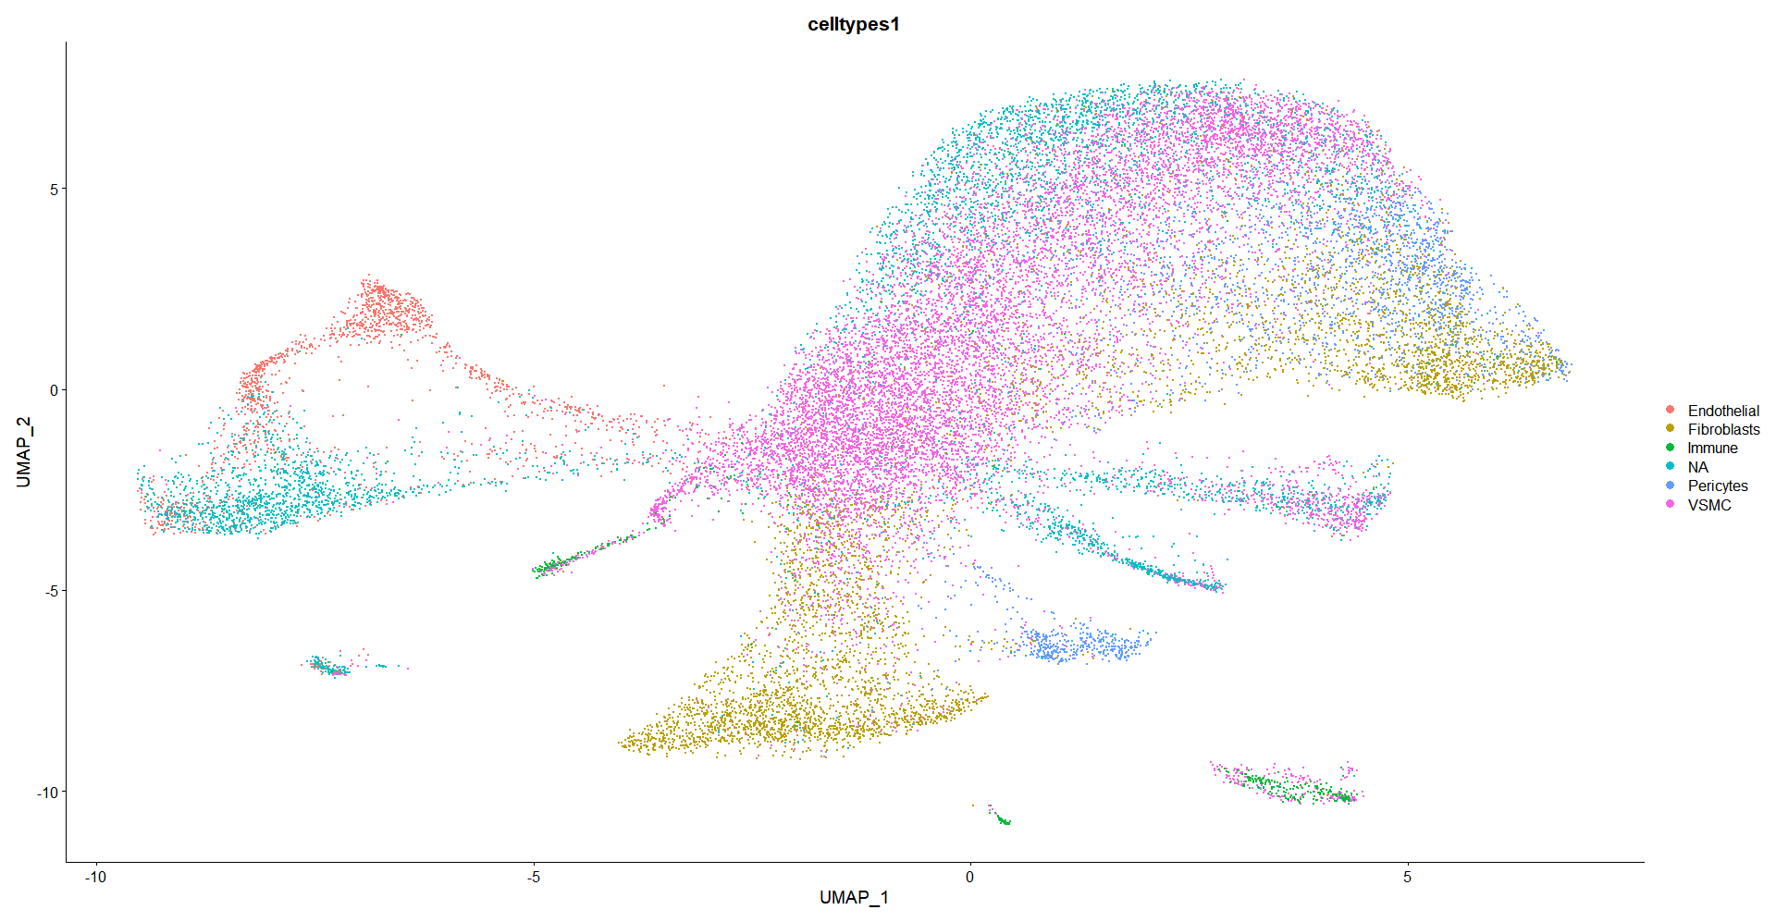
Reintegration – MH6 and MH7 only, showing labels generated per sample

Slide 6
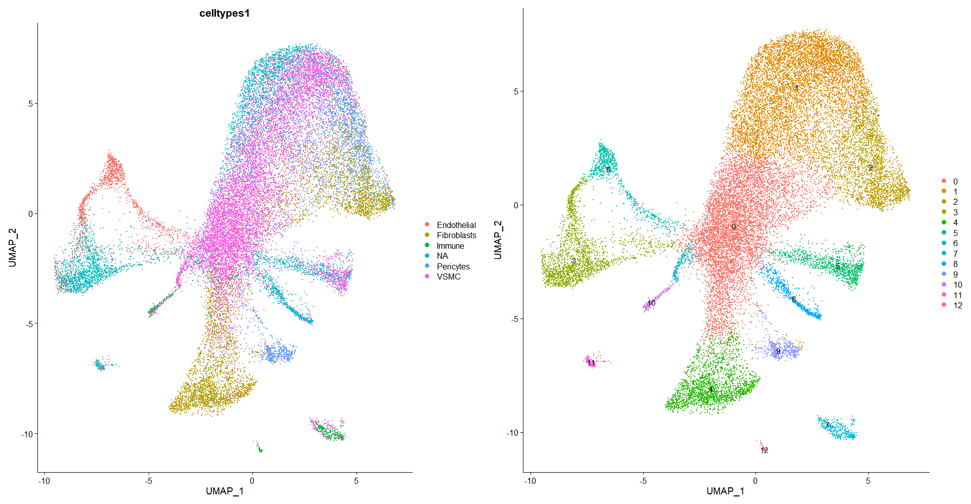
0- VSMC
1- VSMC
2- Fibroblasts
3- NA
4- Fibroblasts
5- VSMC
6-Endothelial
7-Immune
8-NA
9-Pericytes
10-Immune
11-NA
12-Immune

Slide 7
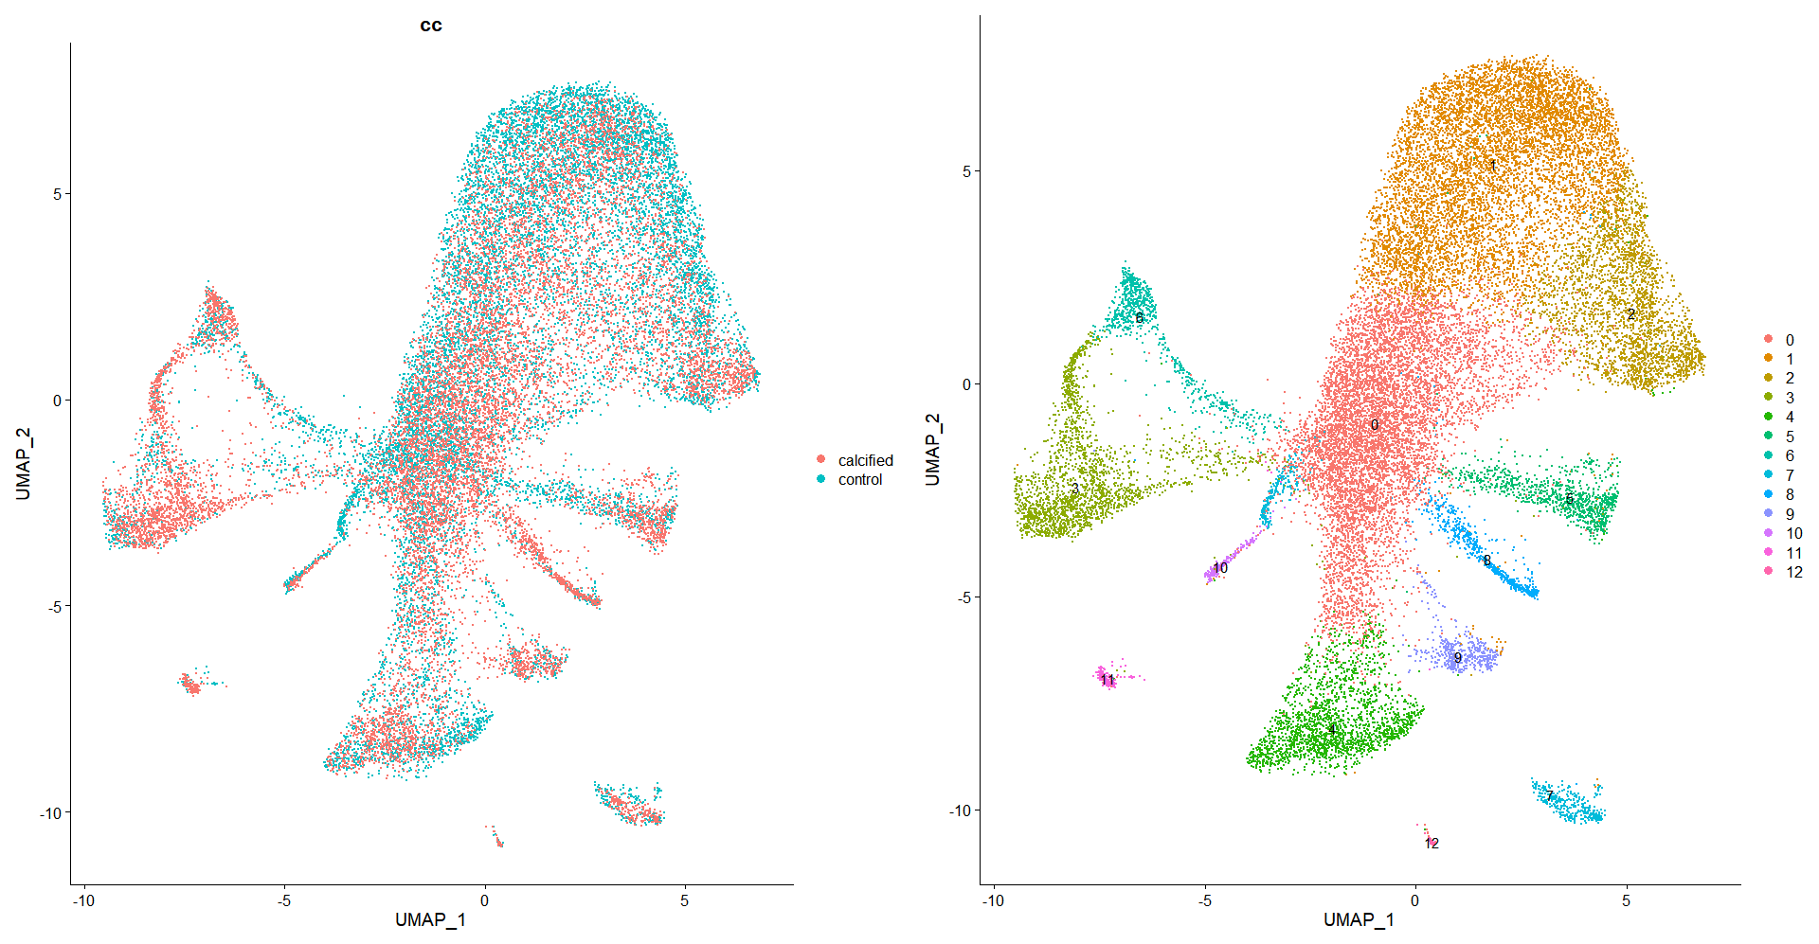

Slide 8
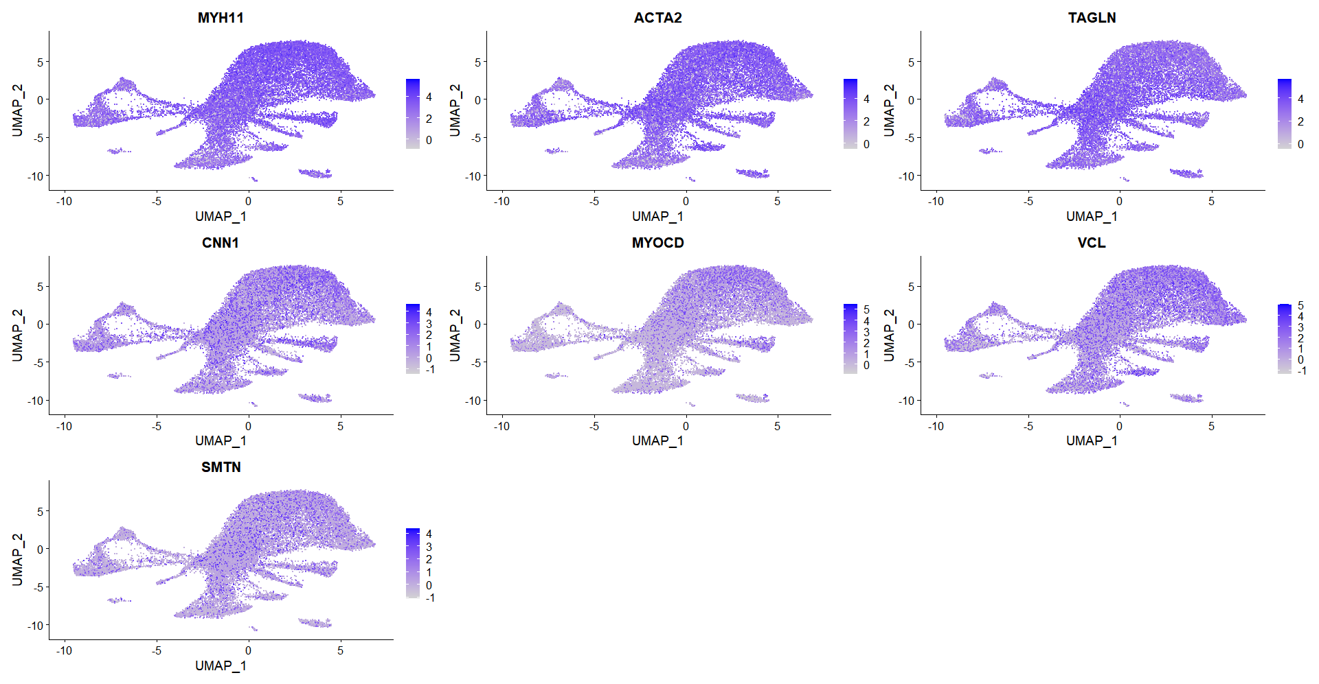
VSMC markers

Slide 9
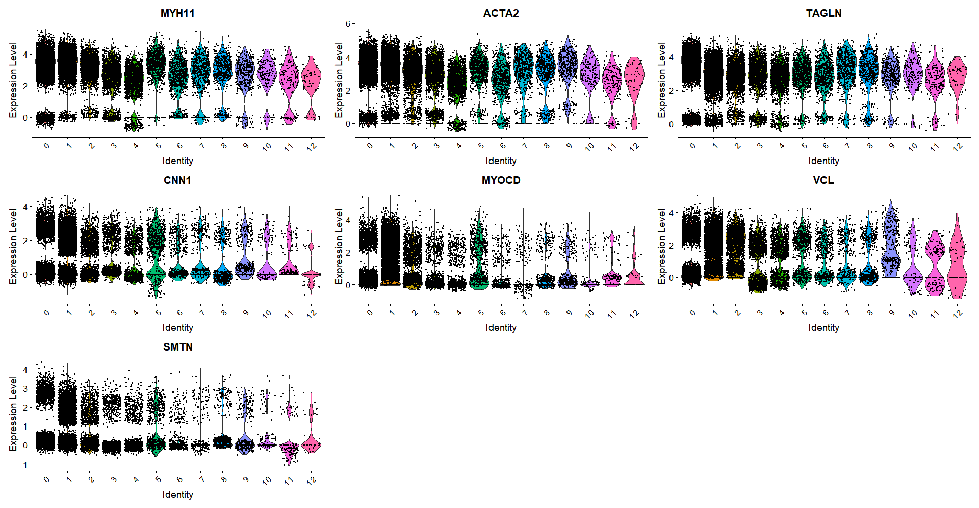
VSMC markers – 0,1,5

Slide 10
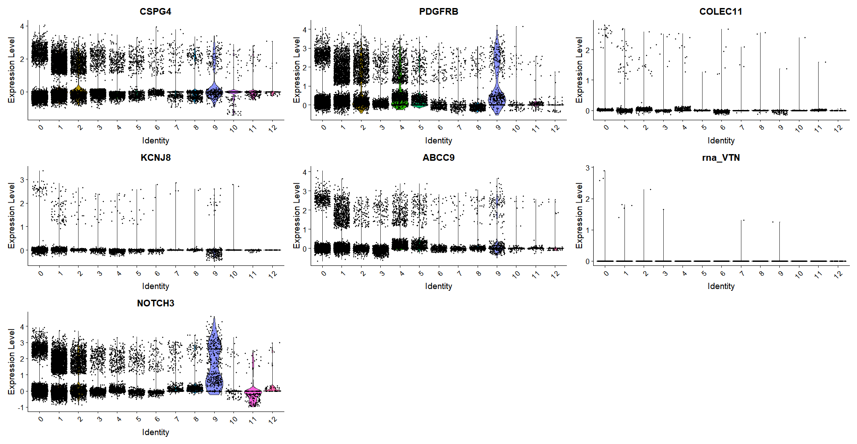
Pericyte markers – 9

Slide 11
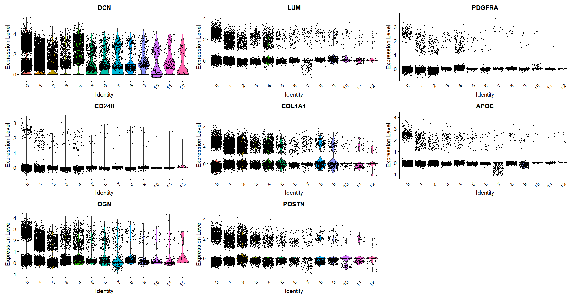
Fibroblast markers – 0?,4

Slide 12
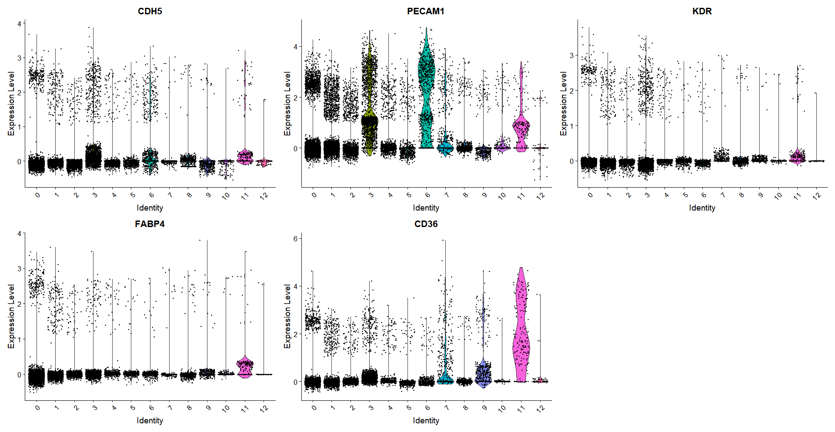
Endothelial markers – 6,11

Slide 13
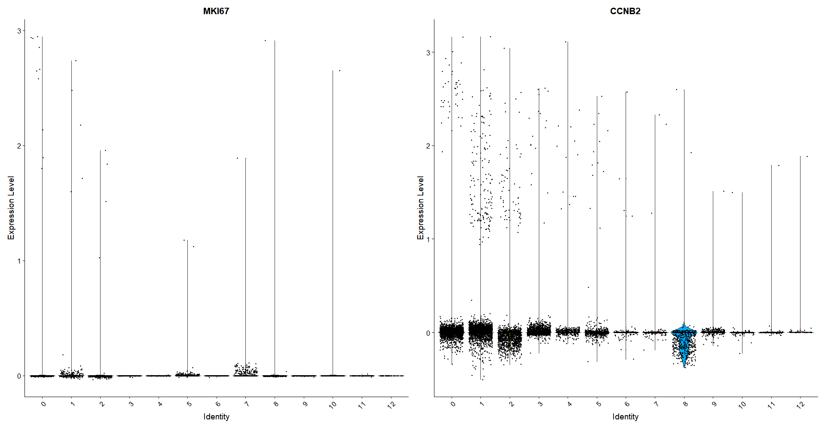
Cellcycle markers

Slide 14
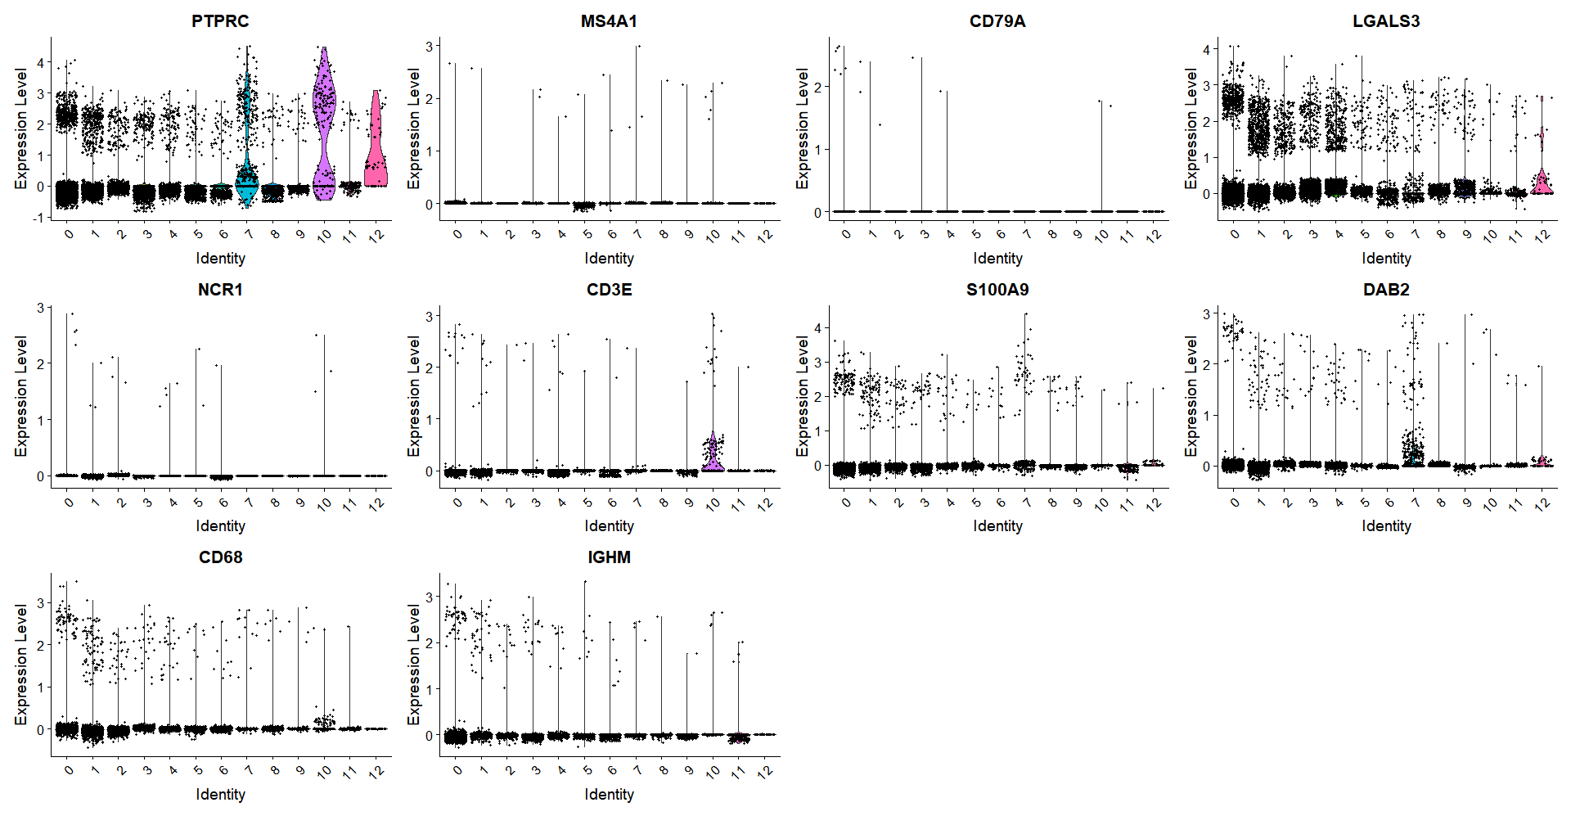
Immune markers – 7,10,12

Slide 15
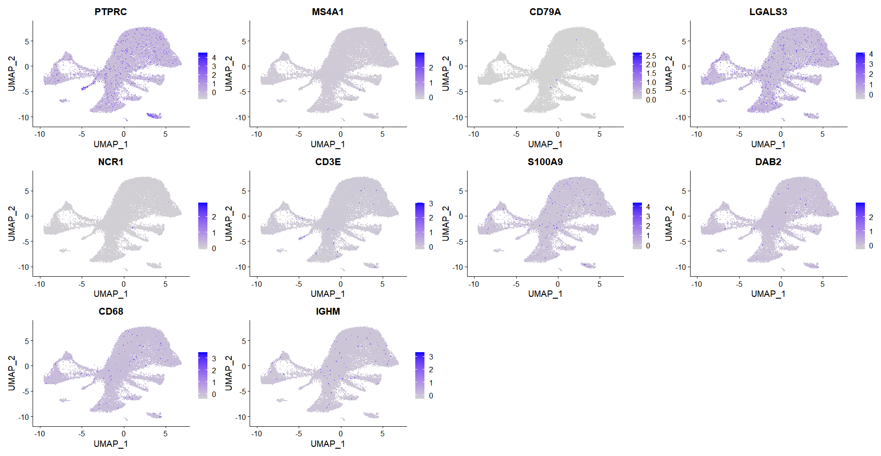
Immune markers

Slide 16
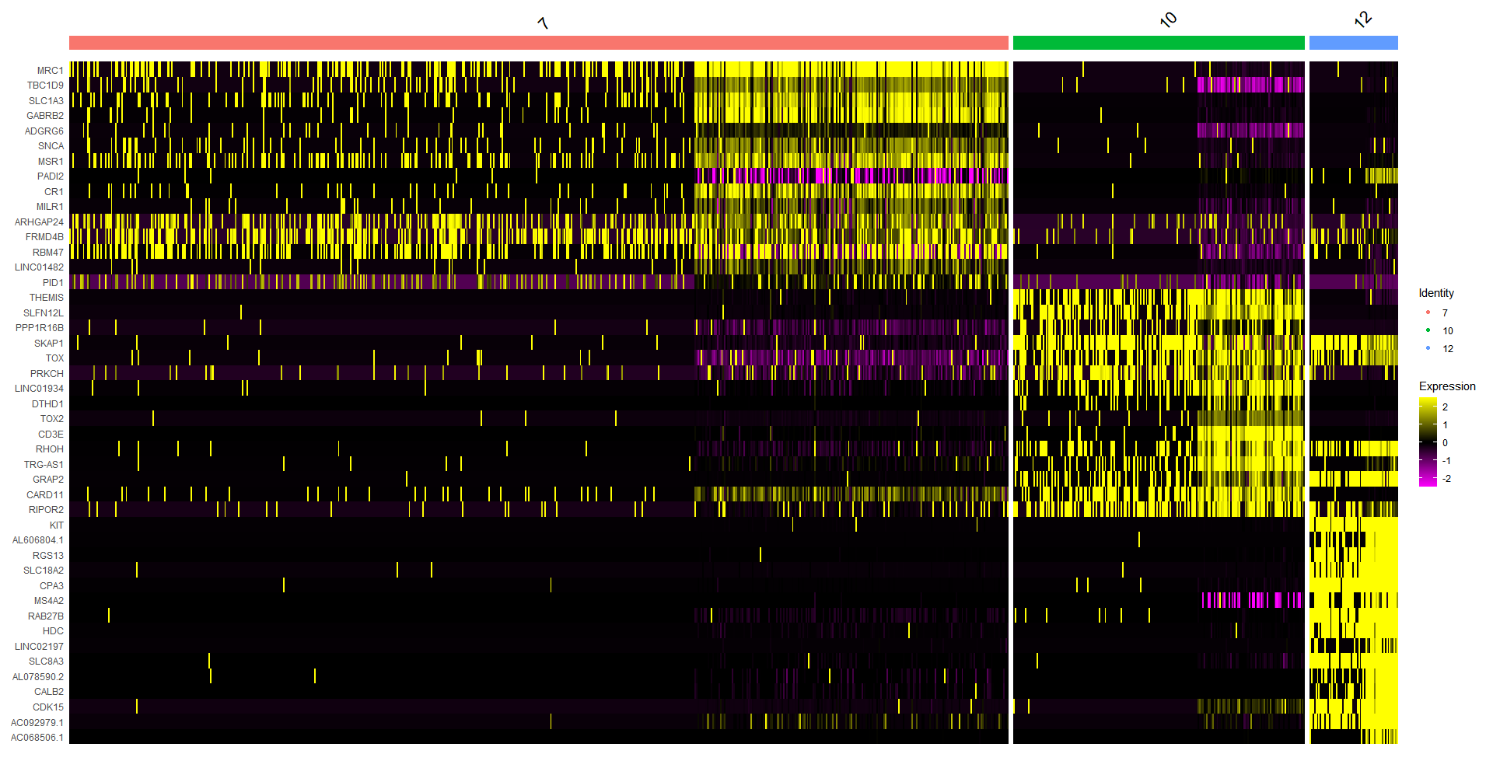
Top features in immune clusters

Slide 17
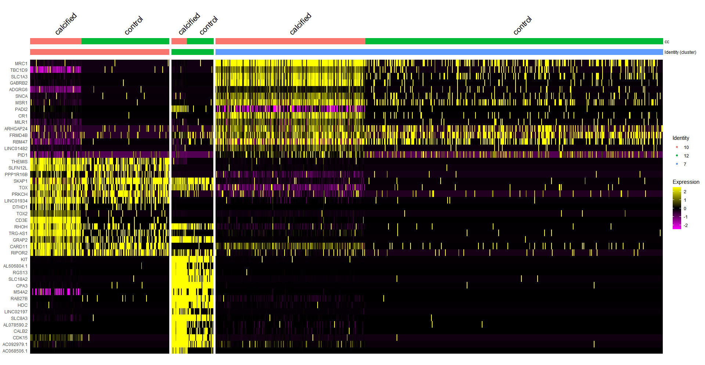
Top features in immune clusters

Slide 18
Final cell labels
0- VSMC
1- VSMC
2- Fibroblasts
3- Endothelial
4- Fibroblasts
5- VSMC
6-Endothelial
7-Immune
8-NA
9-Pericytes
10 - T–cells
11-Endothelial
12-Granulocytes

Slide 19
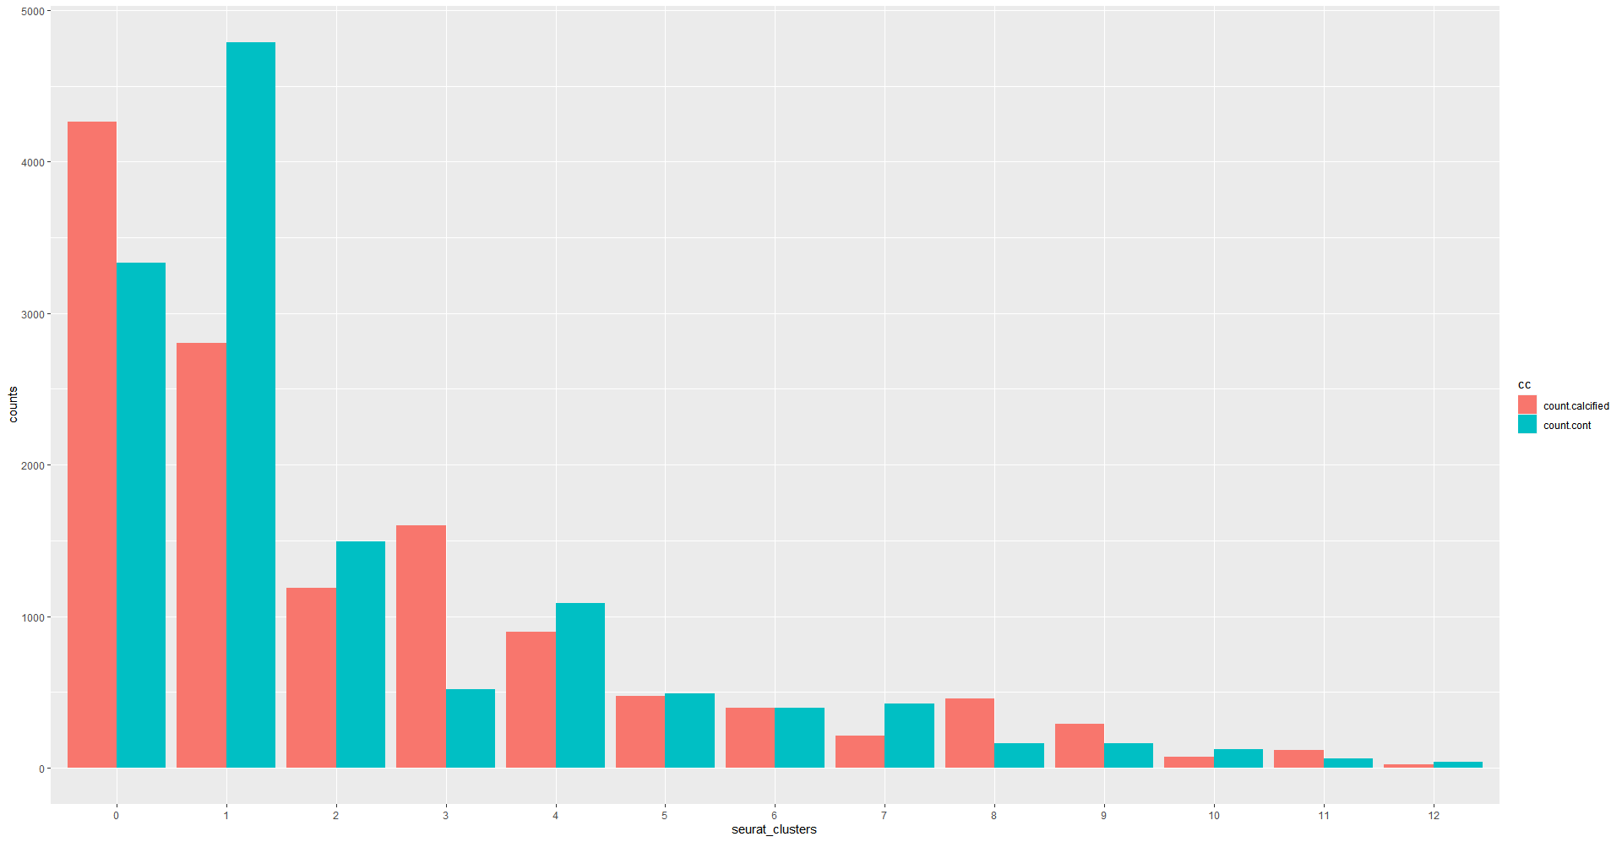
Proportion of calcified and not in cases and controls

Slide 20
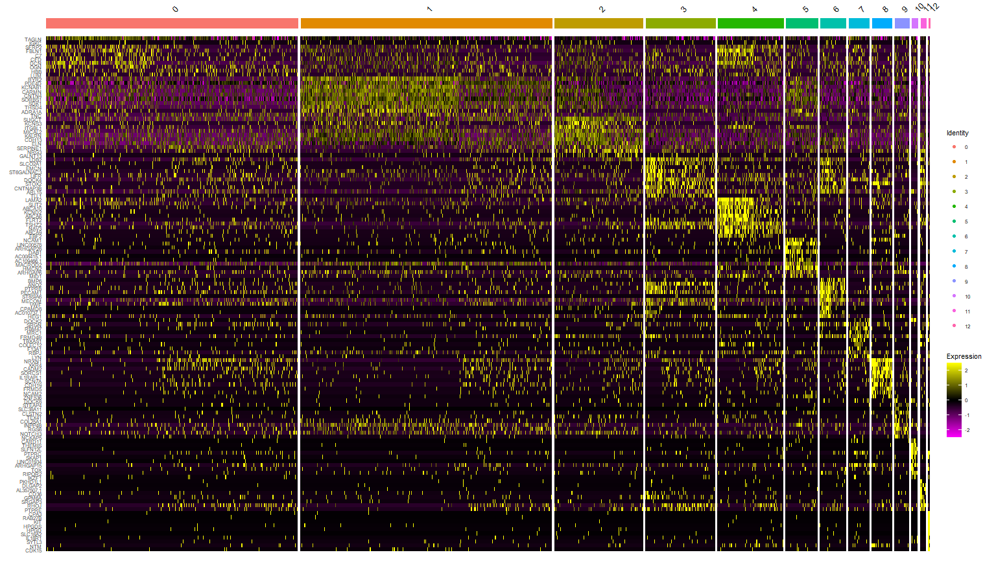

Slide 21
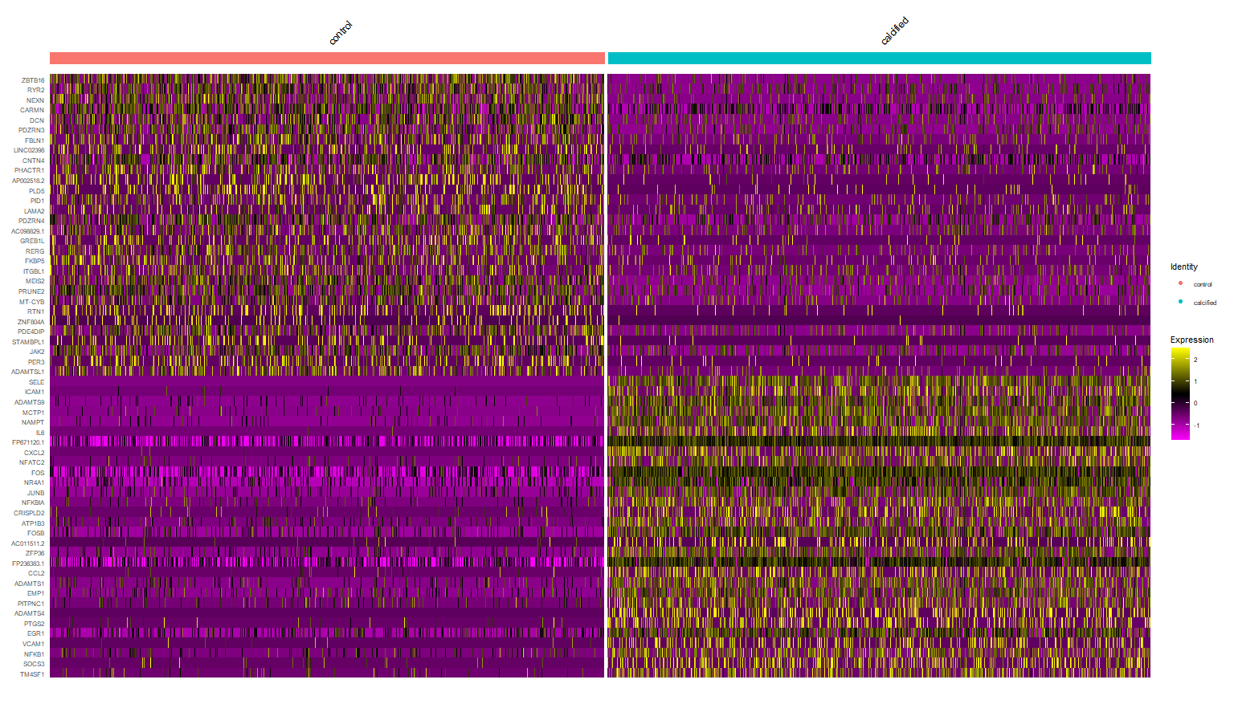

Slide 22
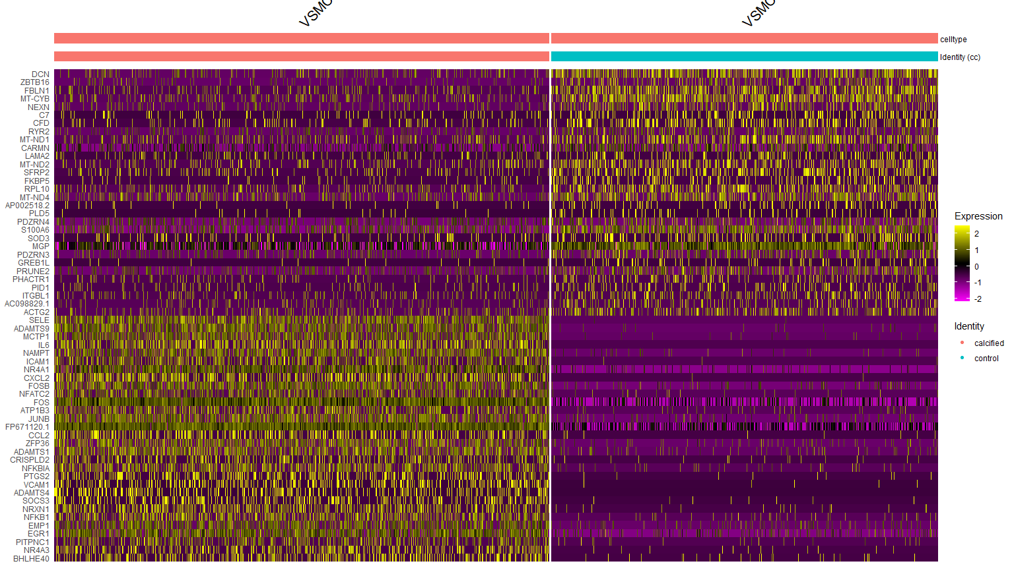
Cluster 0 - VSMC

Slide 23
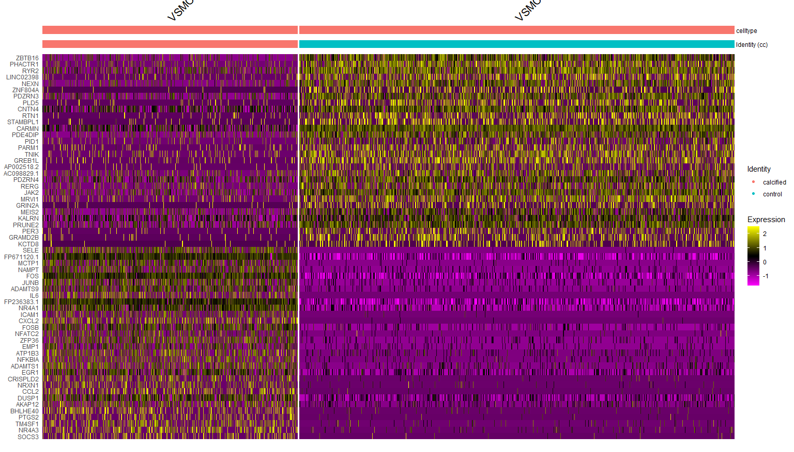
Cluster 1 - VSMC

Slide 24
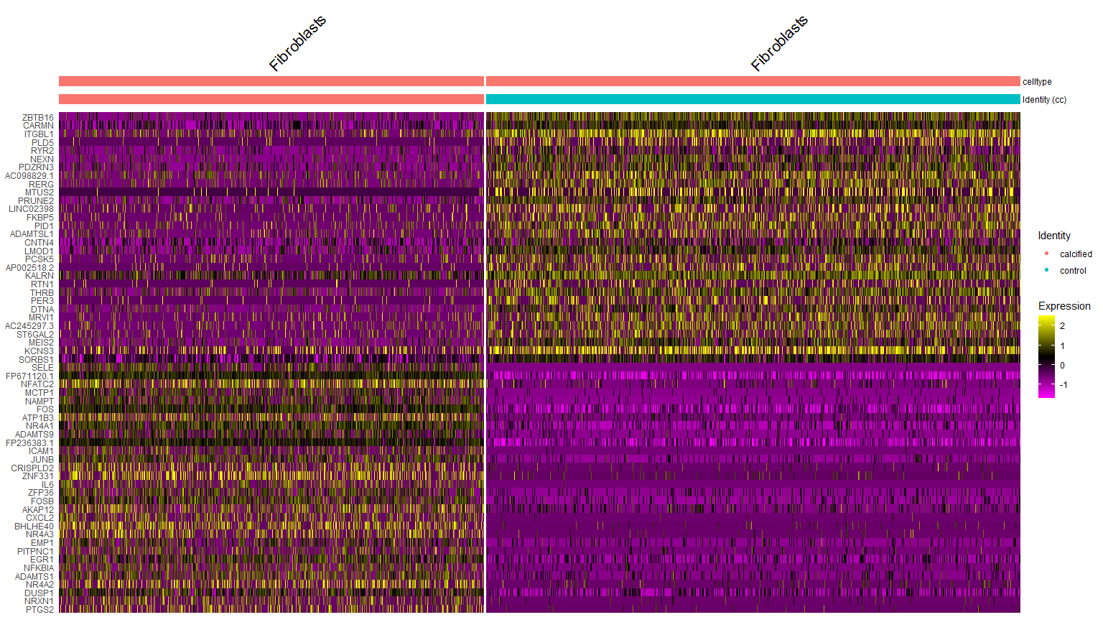
Cluster 2 - Fibroblasts

Slide 25
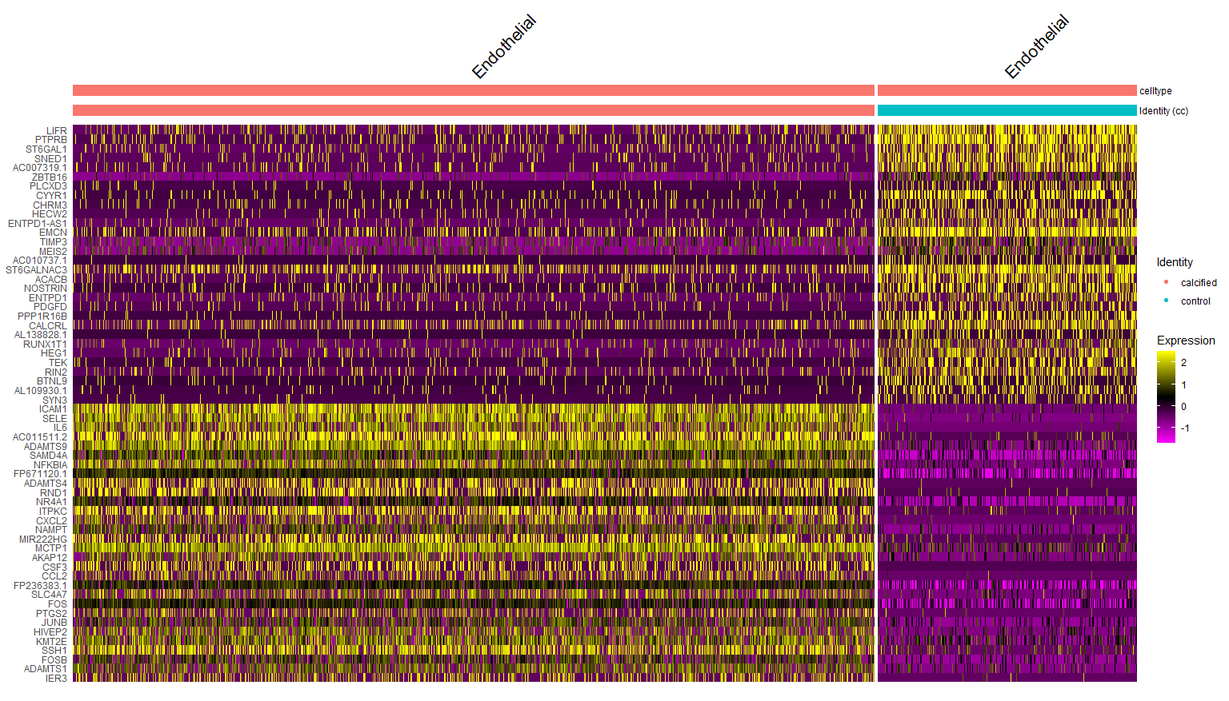
Cluster 3 - Endothelial

Slide 26
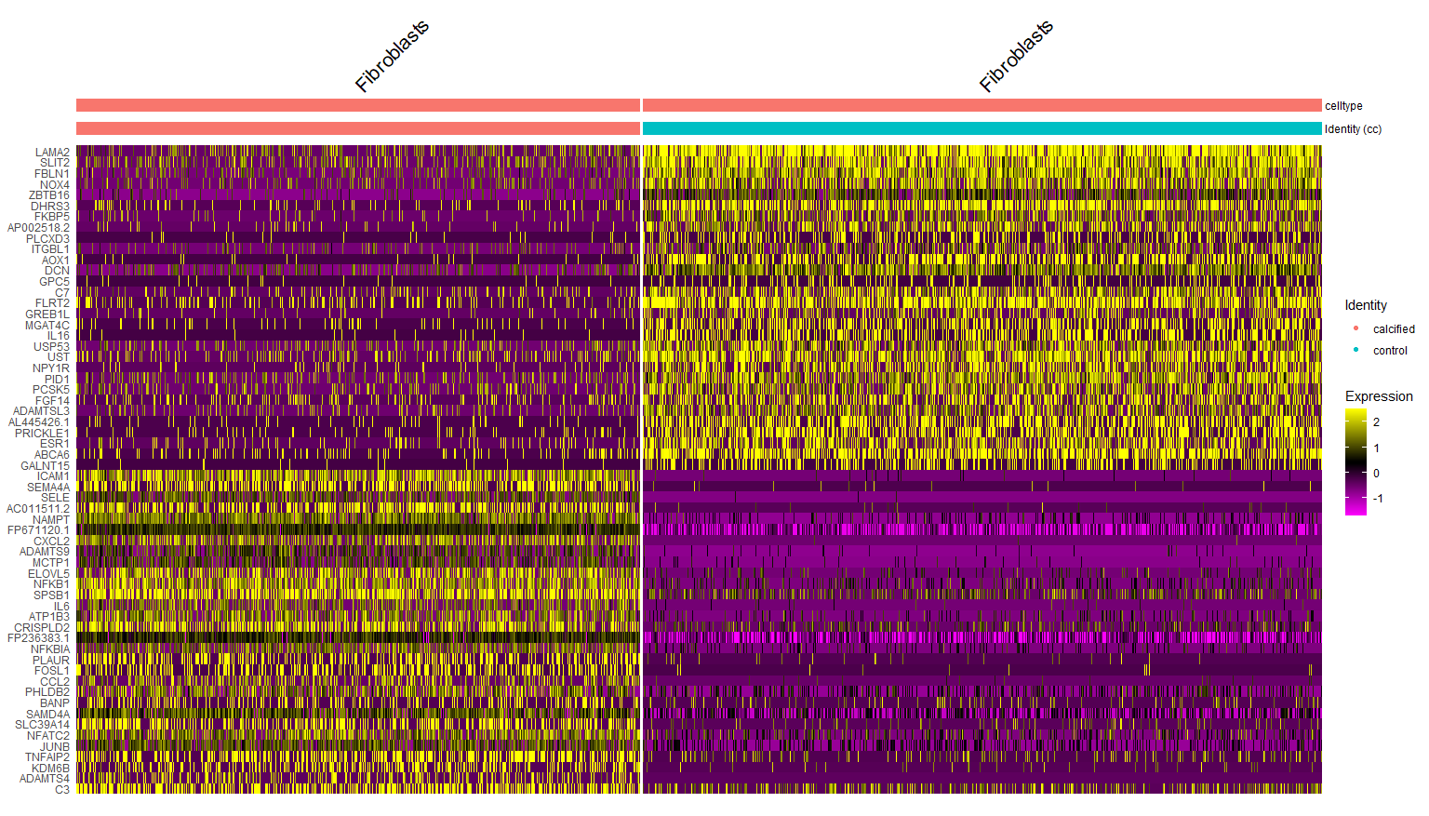
Cluster 4 - Fibroblasts

Slide 27
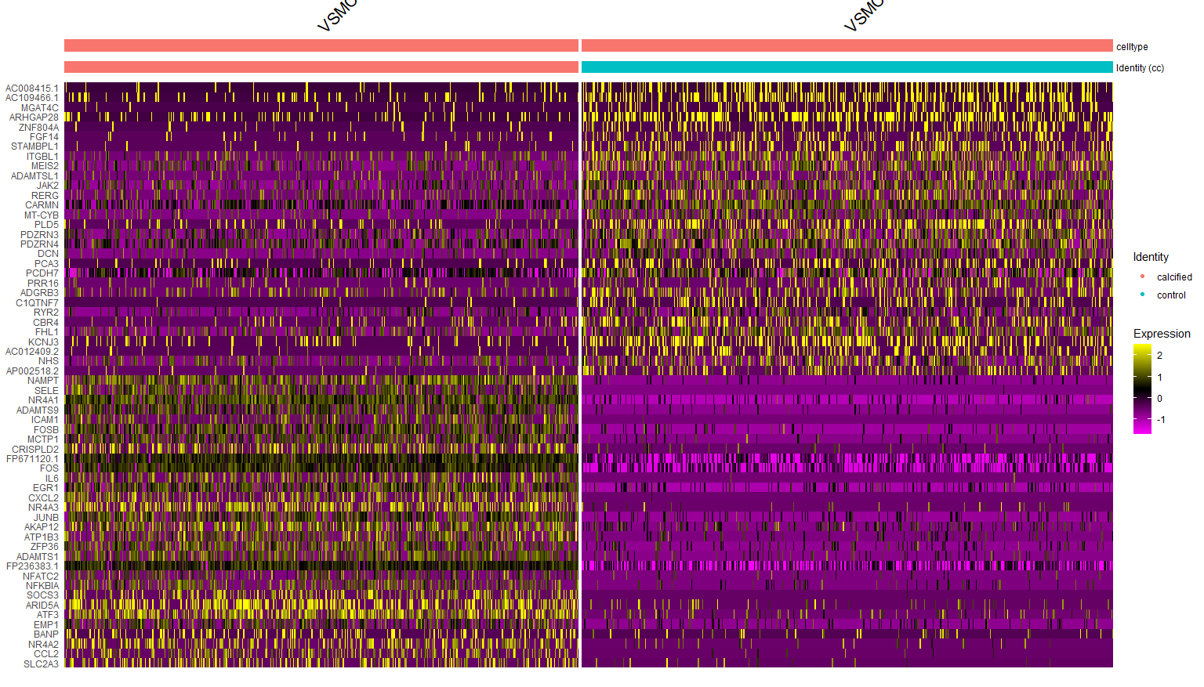
Cluster 5 - VSMC

Slide 28
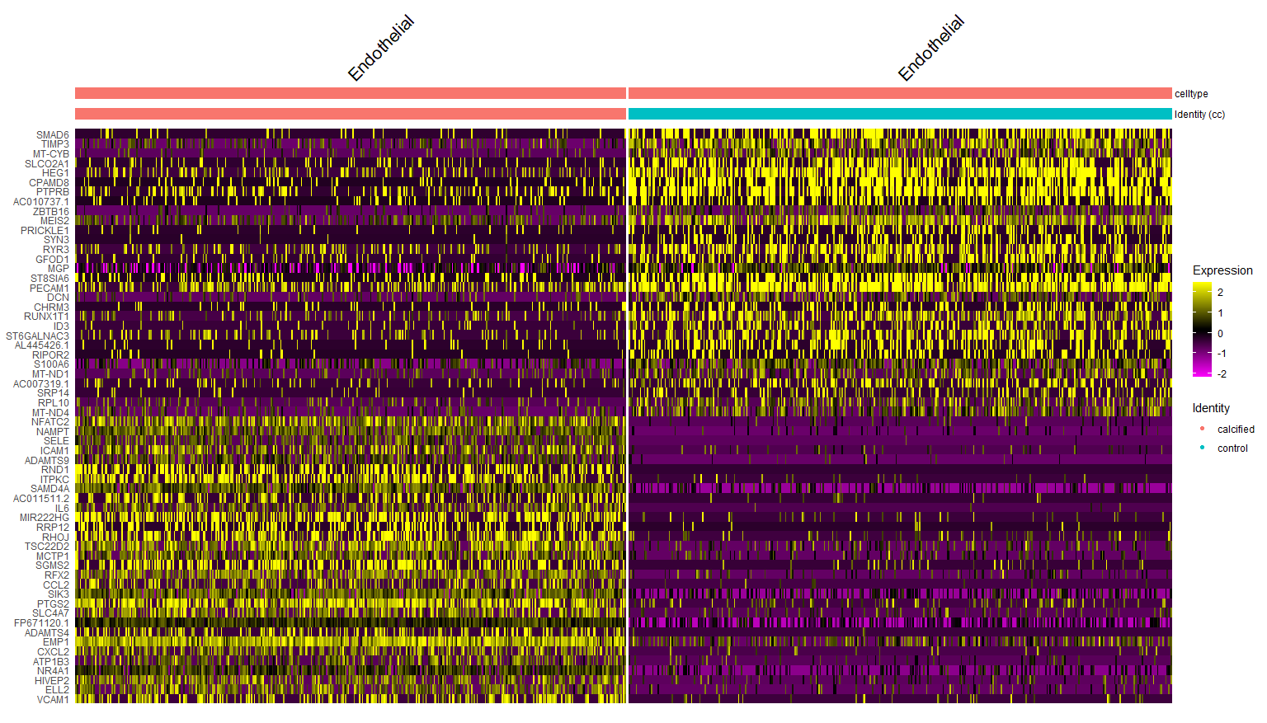
Cluster 6 - Endothelial

Slide 29
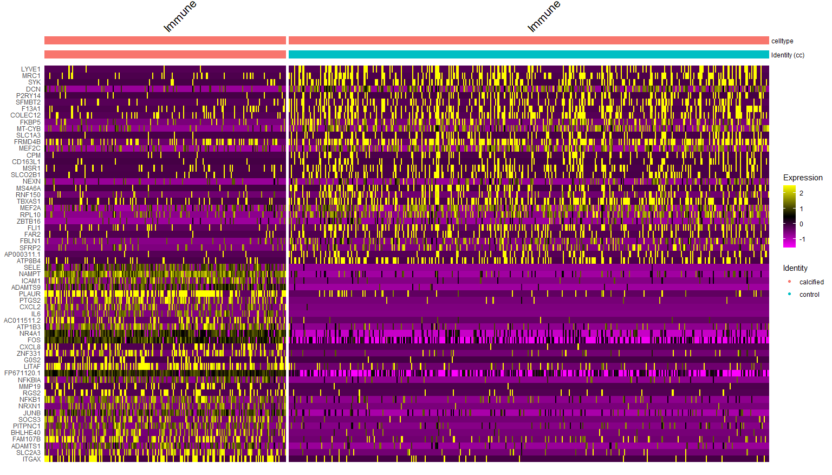
Cluster 7 - Immune

Slide 30
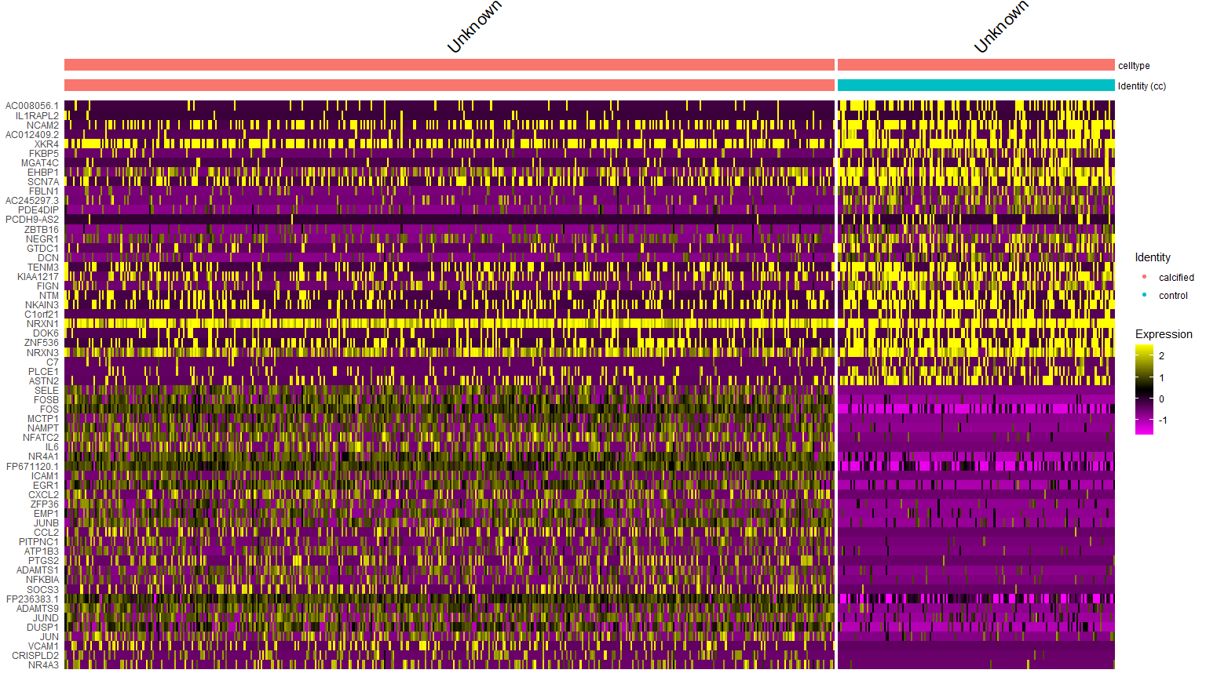
Cluster 8 - Unknown

Slide 31
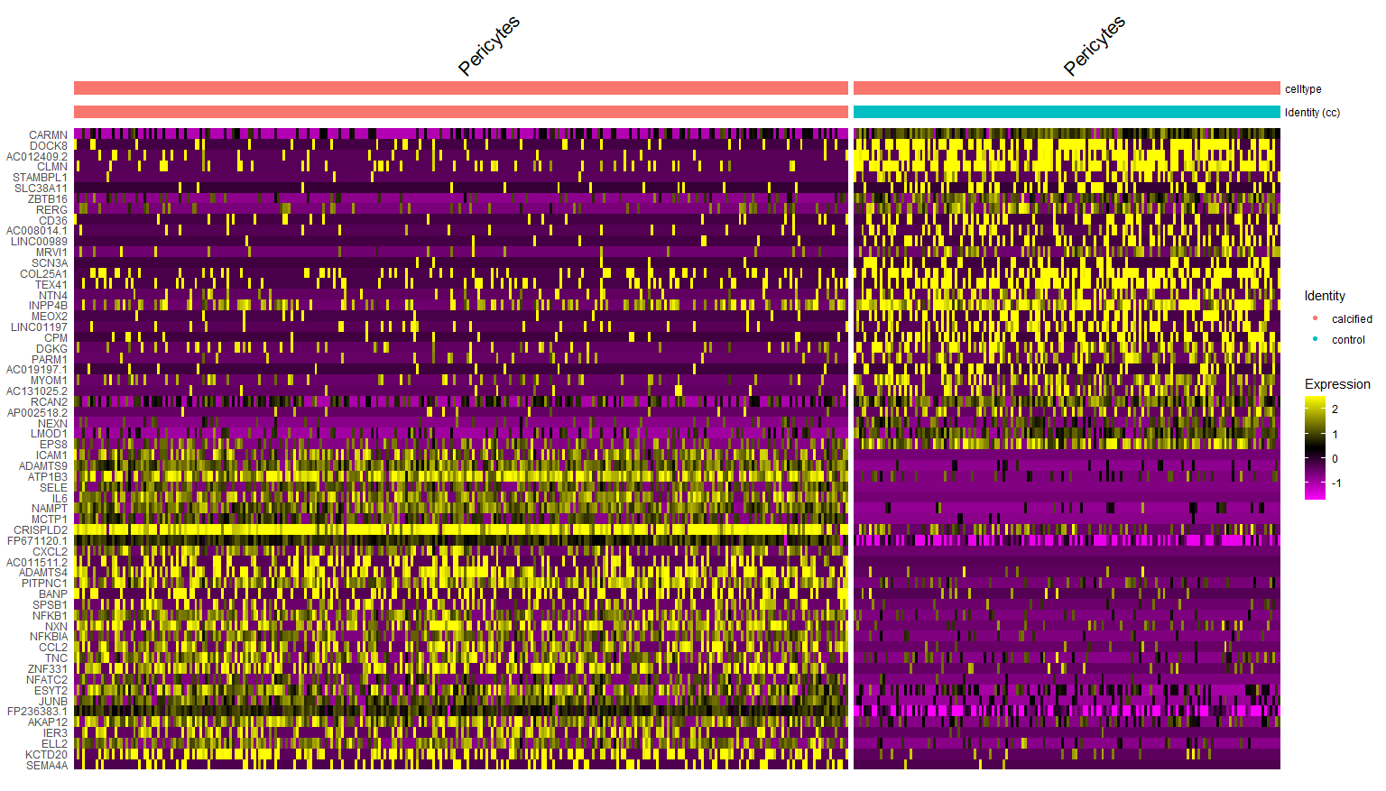
Cluster 9 - Pericytes

Slide 32
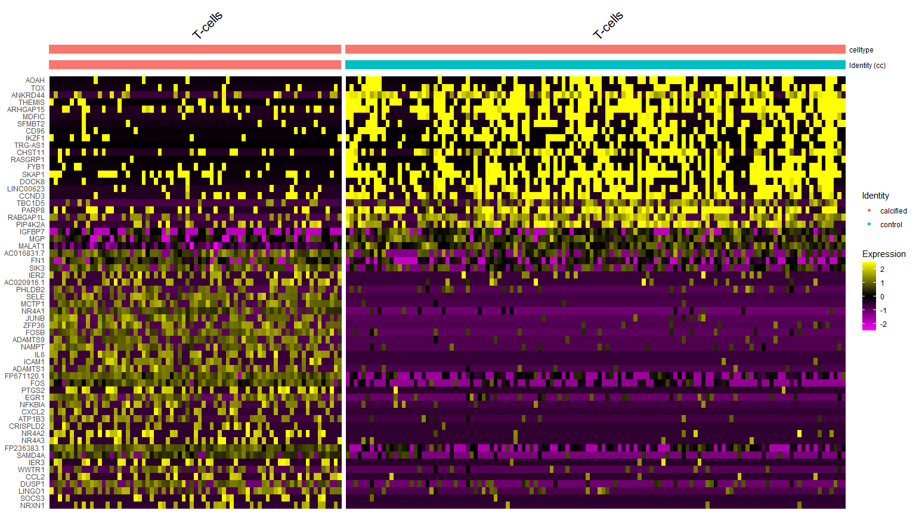
Cluster 10 – T-cells

Slide 33
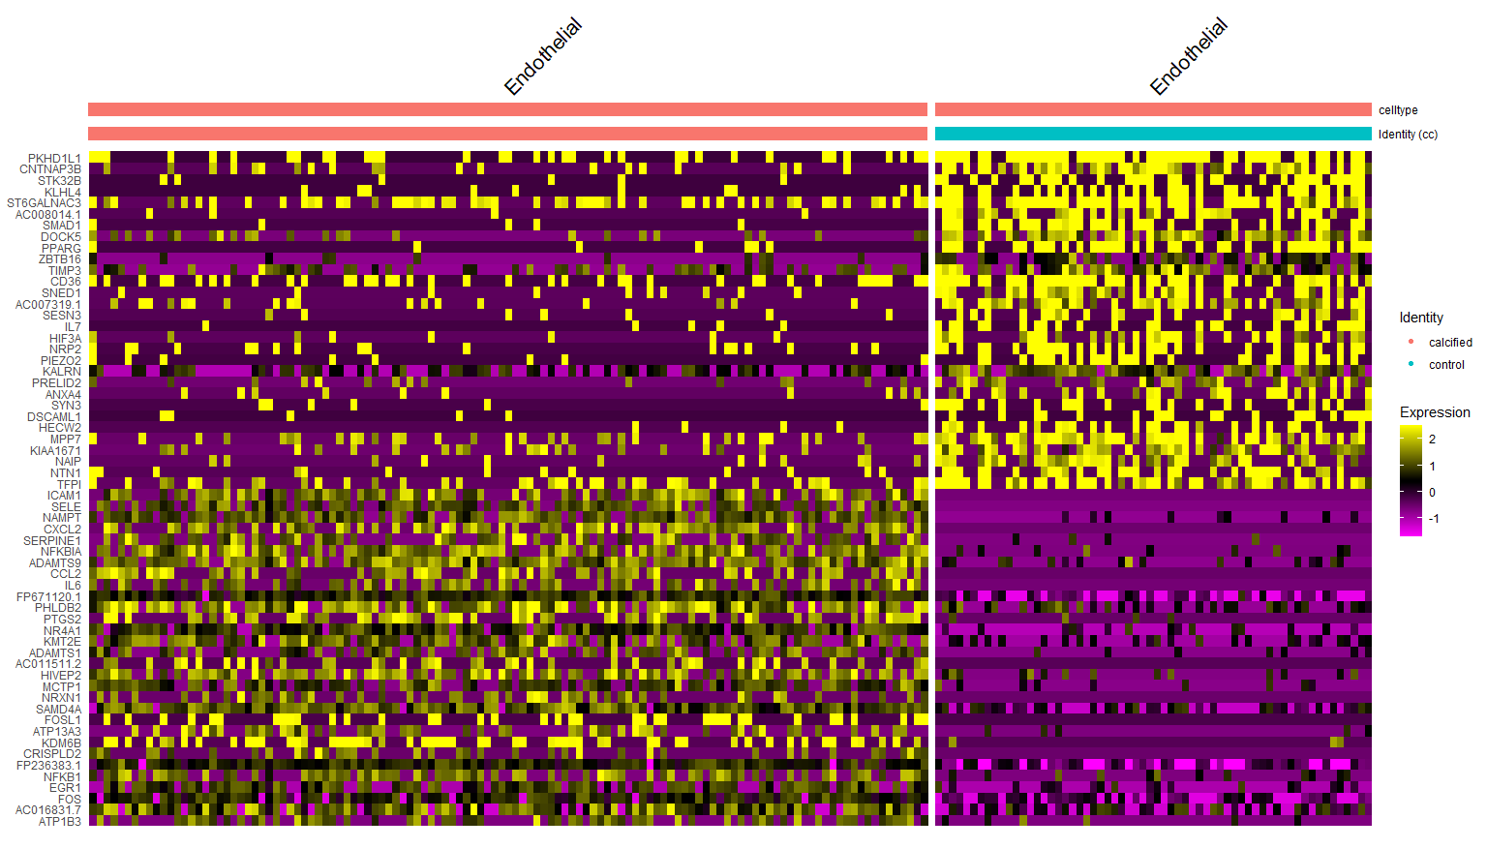
Cluster 11 - Endothelial

Slide 34
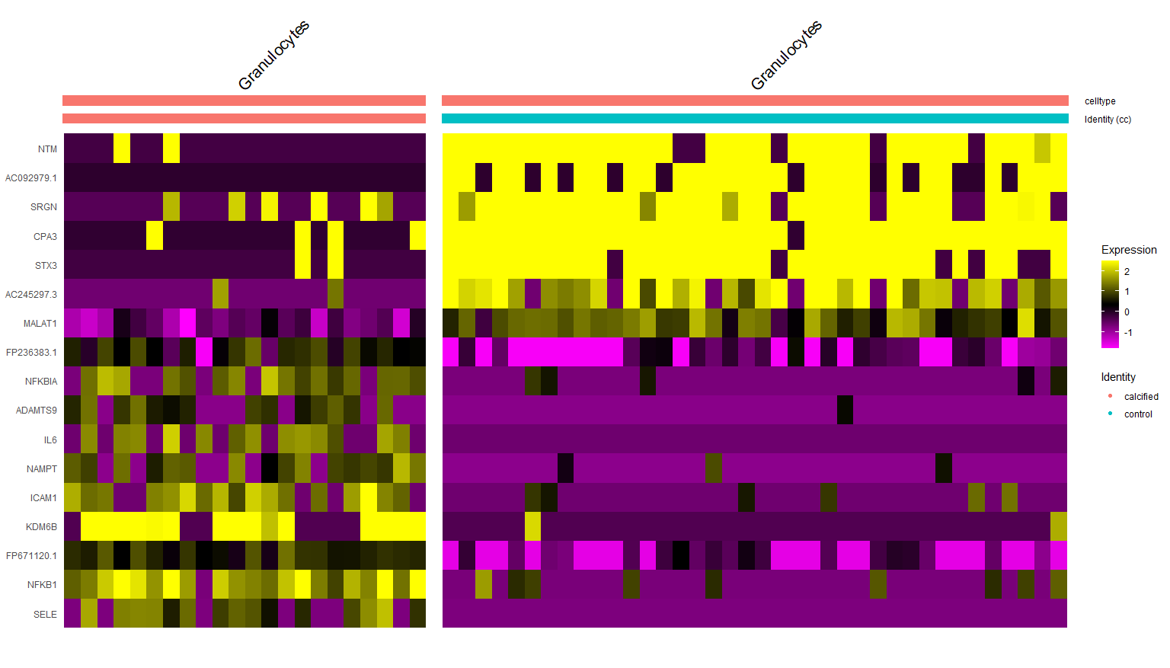
Cluster 12 - Granulocytes

Slide 35
Pathway analysis

Slide 36
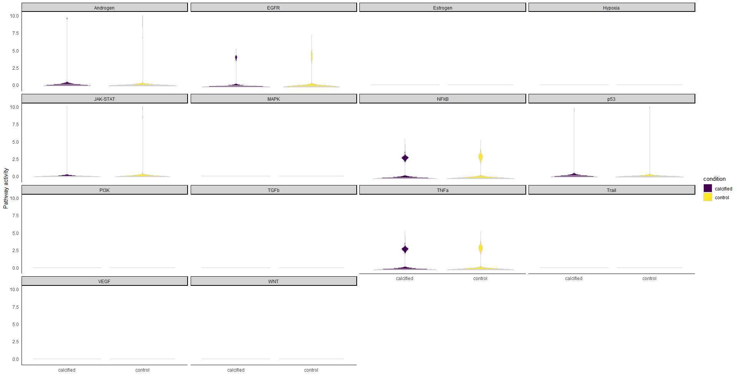
VSMC-0

Slide 37
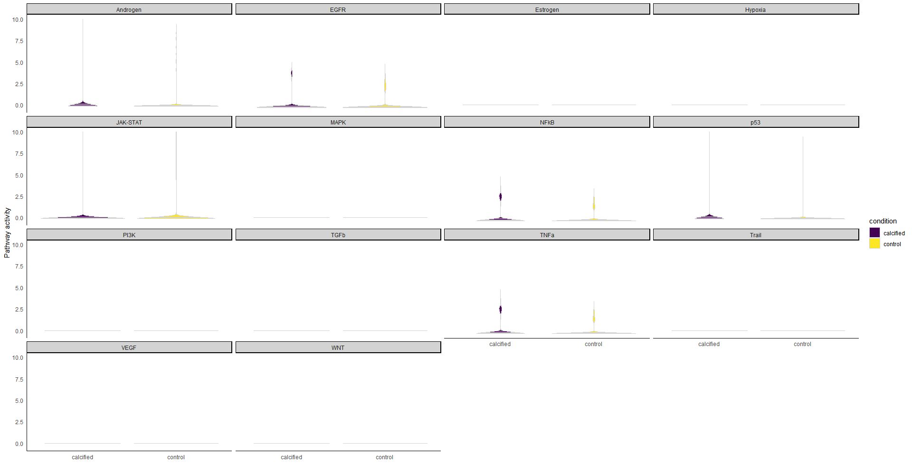
VSMC-1

Slide 38
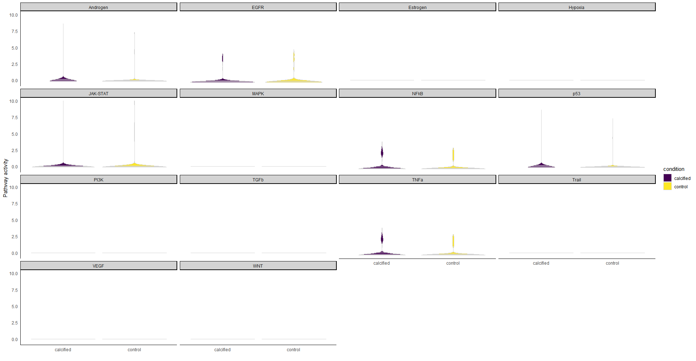
VSMC-5

Slide 39
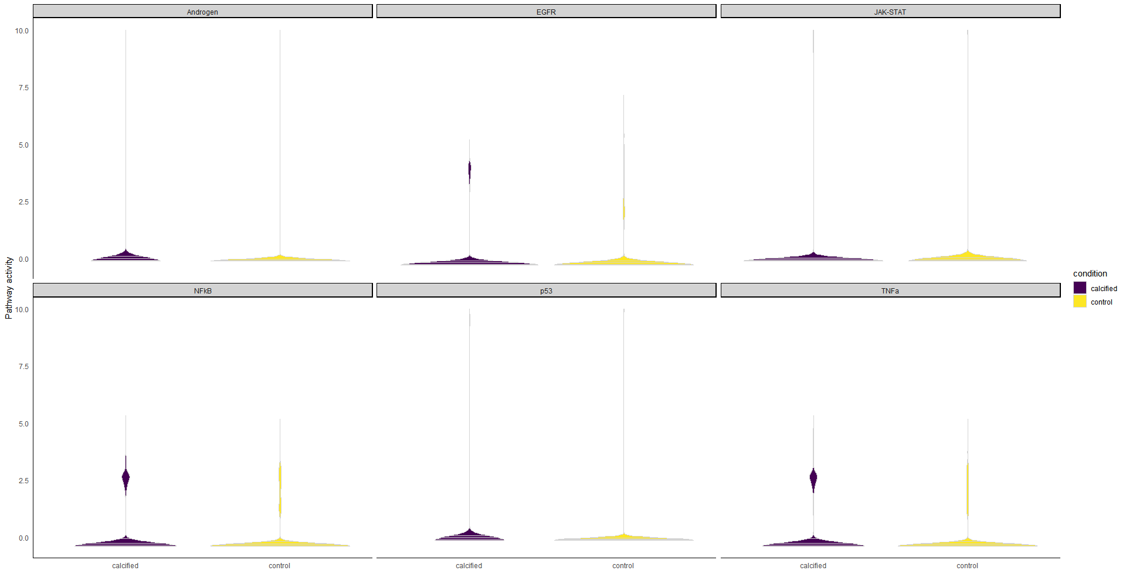
VSMC

Slide 40
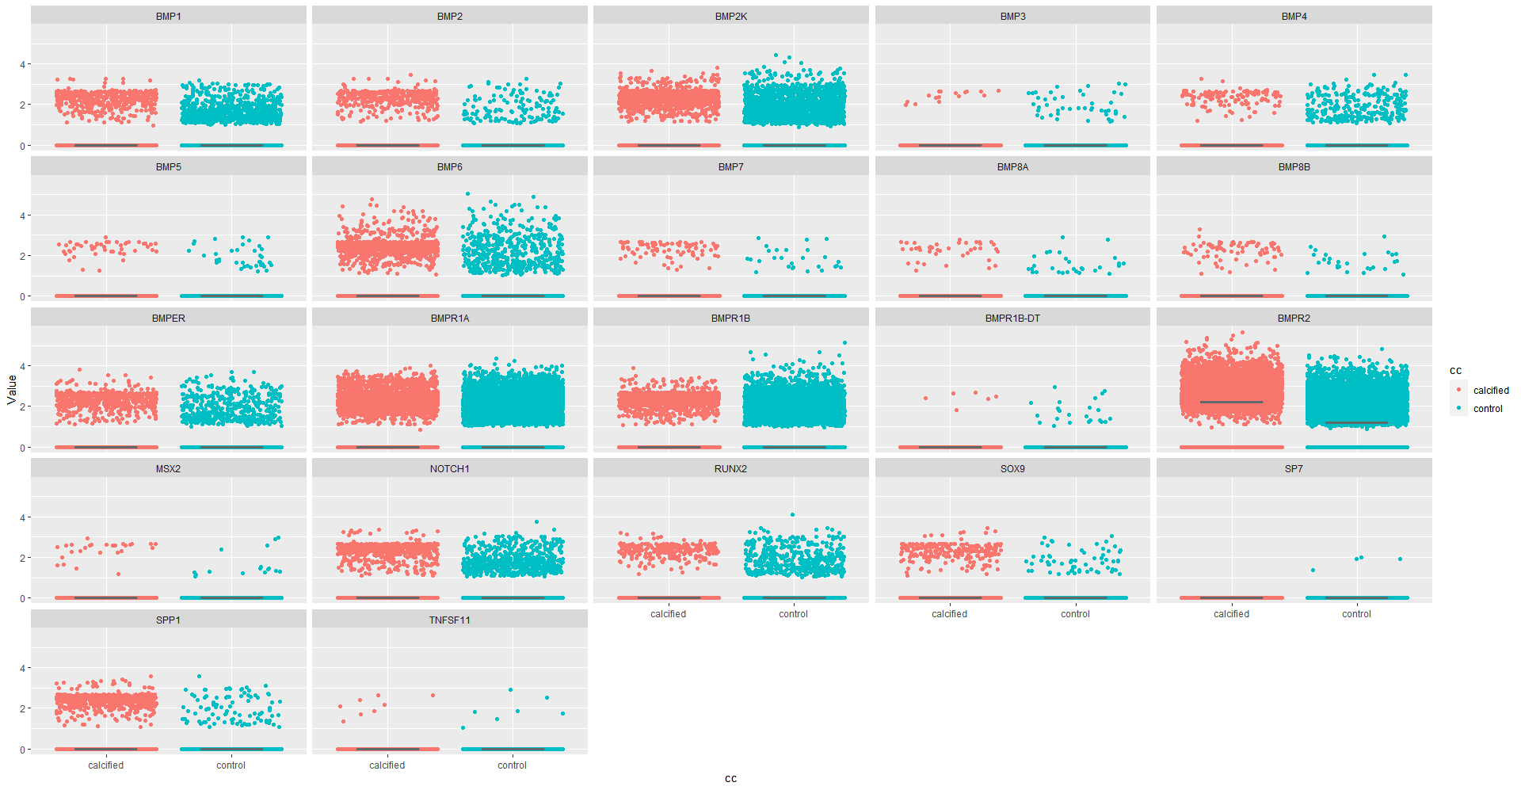
Gene sets – Osteo – c0

Slide 41

Gene sets – Osteo – c1

Slide 42
Gene sets – Osteo – c5

